Slide 1
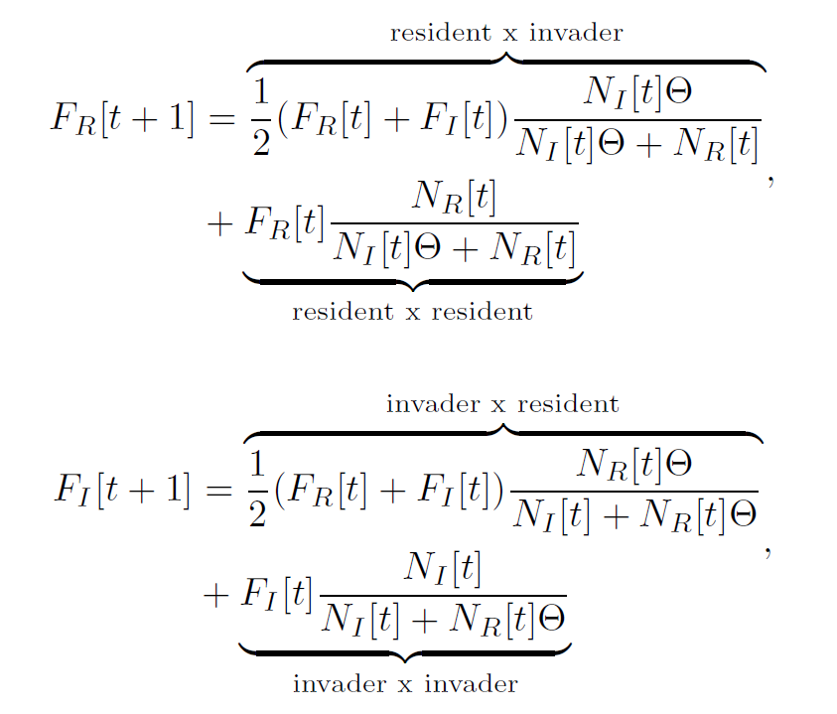
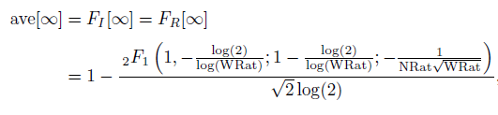

Evolutionary Rescue and Hybridization
Balancing Genetic & Demographic Swamping
Introduction:
Problem for people: extinction
Problem for theory: relative vs absolute fitness
Genetic swamping
Calculate offspring
Assortative Mating
Offspring becomes parents
Viability selection
Conclusion:
Trade off
Future:
- Latency to introduce invader
_{F.J.H. de Haas & S.P. Otto}

